Slide 1

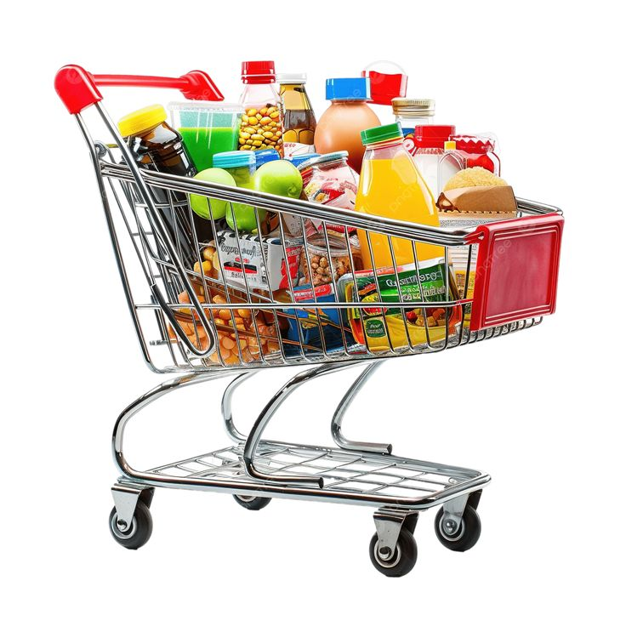

Fresh Mart Superstores Analysis Report
Group 10 presentation

Slide 2


Business Objective
The main objective of this analysis is to gain insights into sales performance, customer segmentation, payment preferences, and time-based purchasing behavior across multiple supermarket branches.
The goal is to help management make informed, data-driven decisions to improve sales, enhance customer experience, and optimize operations.

Slide 3
Dataset Overview
The dataset consists of one fact table and five dimension tables, with a total of 1,000 rows.
Tables:
Fact Table – Supermarket Sales (12 columns) Contains key transactional (Numerical values)
Dimension Tables:
City (3 columns) – holds information on branch location , city and Invoice Id
Product (2 columns) – contains product line and invoice id.
Payment (2 columns) – captures payment method and invoice id.
Customer (3 columns) – holds customer type, gender, and invoice id information.
Calendar (5 columns) – includes date, day, month, quarter, and year fields for time-based analysis
This star schema data model allows efficient analysis of sales trends, customer behavior, and revenue performance through different dimensions.

Slide 4
Business Problem
The supermarket chain operates multiple branches (A, B and C) across different cities( Naypyitaw, yangon and mandalay) and manages a wide range of product lines (Electronic accessories, Fashion accessories, Food and beverages, Health and beauty, Home and lifestyle, Sports and travel) , payment methods ( Cash, Credit card and Ewallet), and customer categories( Member and Normal) .
However, management faces challenges in understanding key sales drivers and identifying performance gaps across locations and customer groups.
Despite having consistent transaction records, the organization lacks a comprehensive analytical view that connects sales trends, customer behavior, and payment preferences..
The company needs to answer critical business questions such as:
Which city or branch generates the highest sales and gross income?
How do sales vary between customer types (Members vs Normal) and gender groups?
What are the most profitable product lines and most preferred payment methods?
At what time of the day and on which days are sales highest

Slide 5
Setting Clear Metrics
A dedicated Measure Table was created in Power BI using DAX to compute KPIs such as:
Total Revenue
Total Gross Income
Total Orders
Average Rating
Total Number of customer

Slide 6
Gathering the Data
The dataset used for this analysis was provided as part of an assessment project for Women Techsters Fellowship, Class of 2026, under the supervision of our tutor, Ms. Bolatito Sarumi. The dataset was extracted from the ZIP folder, renamed as Assignment Project, imported into Power BI using Get Data from powerbi, and transformed into structured queries for cleaning.

Slide 7
Cleaning the Data
Data cleaning included:
Promoting first row to headers in Sales, Customer and Product tables
Removing duplicate transactions using Invoice ID
Checking for consistency and column uniformity
Validating Quantity column — no errors found, 100% valid
Creating a Payment Dimension Table
Applying Fact-Dimension naming standards
Adding conditional time-of-day column for order classification
Creating relationships in Model View before final visualization in Report View

Slide 8
Data Analysis and Key Insights
✅ Overall Performance
Total Revenue: 323,000
Total Gross Income: 15,000
Total Orders: 5,510
Average Rating: 6.97
✅ Branch / City Performance
City with highest total sales: Naypyitaw (111,000)
Followed by Yangon (106,000) and Mandalay (196)
All cities show increased performance in January and March
✅ Customer Segmentation
Member customers generated 164,223 in sales
Normal customers generated 158,743
Female customers made 2,869 purchases, slightly higher than Male with 2,641
→ Female Members appear to be the most valuable customer group.
✅ Product Line Performance
Food & Beverages had the highest revenue: 56,145
Fashion Accessories received the highest customer rating: 1,251

Slide 9
Data Analysis 2
✅ Payment Method Trends
Most preferred: E-wallet with 345 customers
Followed closely by Cash (344) and Credit Card (311)
→ Digital payments are rising across all branches.
✅ Sales Trends
Best performing month: March – 25,771
Peak sales hour: 2 PM – 3 PM
→ Busiest day: Saturday
✅ Daily Orders
Highest: Saturday (919 orders)
Busy across weekdays, but slower on Monday (638 orders
→ Evening and afternoon hours show most transactions
✅ Time of Day Sales
Morning (9am–12noon): 61,799
Afternoon (12noon–4pm): 122,797
Evening (4pm–9pm): 138,371
→ Evening is the strongest shopping period.

Slide 10
Summary
This supermarket successfully generated 323k revenue with 15k gross income from 5510 orders.
Sales are strongest in:
Evenings
Weekends
March
Naypyitaw is the top-performing city, with members and female customers contributing the highest revenue.
Food & Beverages are the most profitable products and drive the most revenue while Fashion Accessories delight customers the most and E-wallet is the most preferred payment method, meaning Digital payments are becoming more popular.
The supermarket has strong performance in both revenue and customer engagement.
Naypyitaw leads in overall sales, Members slightly outperform Normal customers, and Women contribute more orders than men.
Sales peak in the evening, especially on Saturdays.

Slide 11
Recommendations
Increase Staff During Peak Hours:
Based on the analysis, evening hours (4 PM9 PM) and weekends, especially Saturdays, record the highest customer activity. Adding more staff during these periods will help reduce overcrowding, improve customer service, and minimize waiting time.
Enhance Inventory Planning:
Ensure that stock levels are increased during high-demand periods to prevent shortages and missed sales opportunities. This will also help maintain smooth operations during peak times.
Encourage Digital Payments:
Since Ewallet is the most preferred payment method, introducing loyalty points or small discounts for digital payments can increase adoption and speed up checkout processes.
Target Key Customer Segments:
Focus marketing and promotional campaigns on members and female customers, as they represent the most active and profitable segments.
Replicate High-Performing Branch Strategies:
Study the success of the Naypyitaw branch and apply similar strategies—such as pricing, promotions, or customer engagement methods—across other branches.
Continuous Staff Training:
Regularly train staff on customer service, sales techniques, and digital tools to maintain efficiency and improve customer satisfaction
Introduce Festive and Occasional Incentives:
Offer special discounts, promotional bundles, or loyalty rewards during festive seasons and public holidays. This will attract more customers, boost sales, and enhance brand loyalty during high-traffic periods.

Slide 12
Conclusion
The supermarket sales analysis provided valuable insights into the company’s overall performance, customer behavior, and sales trends across branches. Using a structured data model consisting of one fact table and five dimensions tables, the analysis effectively captured key business metrics such as total revenue, gross income, customer segmentation, product performance, and payment preferences.
Findings revealed that Naypyitaw recorded the highest sales, Food and Beverages generated the most revenue, and E-wallet emerged as the most preferred payment method. The data also showed that members and female customers contributed significantly to total sales, while evening hours and weekends experienced the highest purchase activity.
Through Power BI, these insights were presented visually across three report pages — revenue trend, customer segmentation, and time-series analysis — allowing for easy interpretation and data-driven decision-making.
In conclusion, the project successfully demonstrated how analytical tools and techniques can transform raw sales data into actionable insights. The outcomes can help management improve marketing strategies, optimize staffing during peak periods, enhance customer engagement, and increase overall business profitability.

